Slide 1
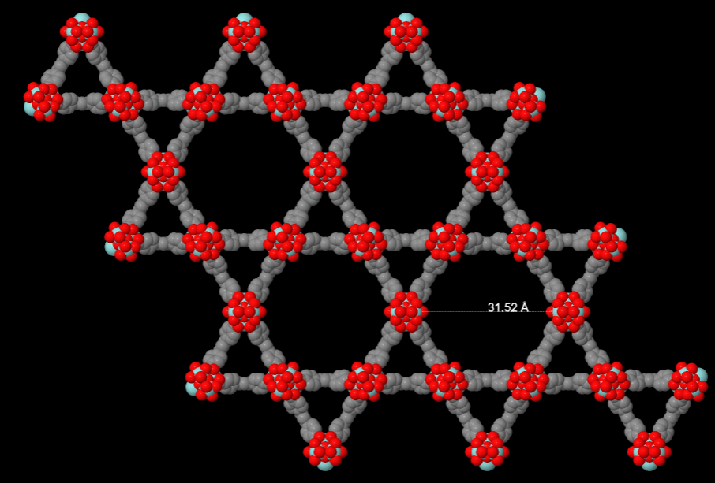
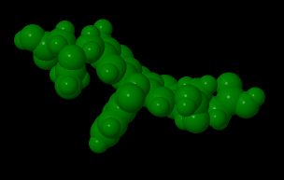

Slide 2
https://chemapps.stolaf.edu/jmol/jmol.php?model=c1ccc2c%28c1%29C%28%3DO%29OC23c4cc%28c%28cc4Oc5c3cc%28c%28c5%29O%29CN%28CC%28%3DO%29O%29CC%28%3DO%29O%29O%29CN%28CC%28%3DO%29O%29CC%28%3DO%29O
https://www.ccdc.cam.ac.uk/structures/search?id=doi:10.5517/cc112318&sid=DataCite

